Slide 1



Hotel Reservation Analysis with SQL
MENTORNESS
Med Skander Gharbi

Slide 2

Table of content
01
SQL
Overview
Dataset Details
SQL Queries
Conclusion
02
03
04
05

Slide 3


SQL (Structured Query Language) is a standardized programming language used for managing and manipulating relational databases. It allows users to create, read, update, and delete data within a database. SQL includes a variety of commands for querying data (SELECT), inserting data (INSERT), updating data (UPDATE), deleting data (DELETE), and defining database structures (CREATE, ALTER, DROP).

Slide 4


Overview
The hotel industry depends heavily on data to make strategic decisions that enhance guest experiences and optimize operations.
This project involves analyzing a hotel reservation dataset using SQL to extract valuable insights regarding guest preferences, booking trends, and other critical factors. The dataset includes information on booking details, guest demographics, stay duration, meal plans, room types, and pricing
By answering specific analytical questions, we aim to uncover patterns and trends that can inform decision-making processes and improve overall hotel management. The insights gained will help in understanding guest behavior, optimizing room occupancy, and enhancing revenue management strategies.

Slide 5

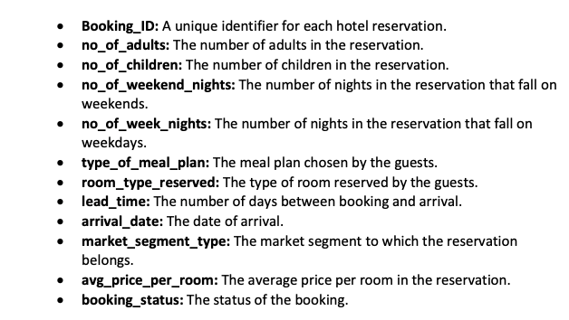


Dataset Details

Slide 6
1. What is the total number of reservations in the dataset?
2. Which meal plan is the most popular among guests?
3. What is the average price per room for reservations involving children?
4. How many reservations were made for the year 20XX (replace XX with the desired year)?
5. What is the most commonly booked room type?
6. How many reservations fall on a weekend (no_of_weekend_nights > 0)?
7. What is the highest and lowest lead time for reservations?
8. What is the most common market segment type for reservations?
9. How many reservations have a booking status of "Confirmed"?
10. What is the total number of adults and children across all reservations?
11. What is the average number of weekend nights for reservations involving children?
12. How many reservations were made in each month of the year?
13. What is the average number of nights (both weekend and weekday) spent by guests for each room
type?
14. For reservations involving children, what is the most common room type, and what is the average
price for that room type?
15. Find the market segment type that generates the highest average price per room.
SQL Queries

Slide 7
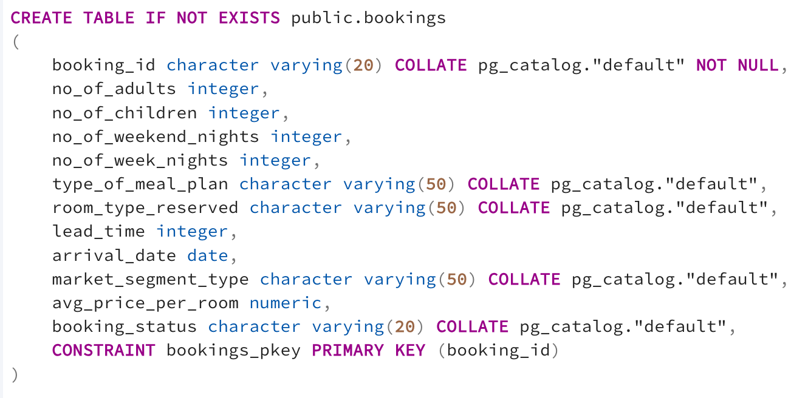

Slide 8
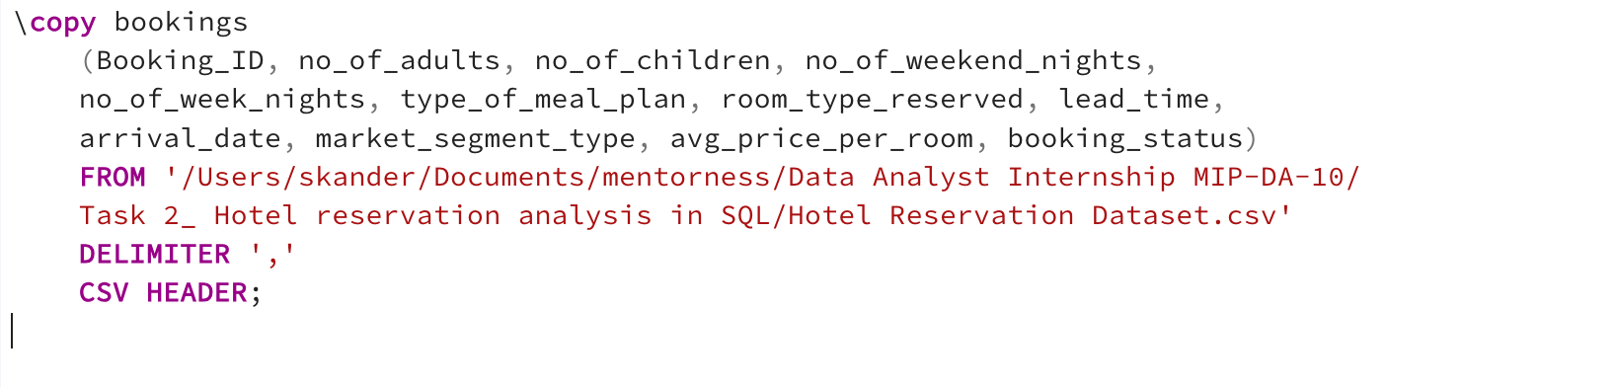

Slide 9
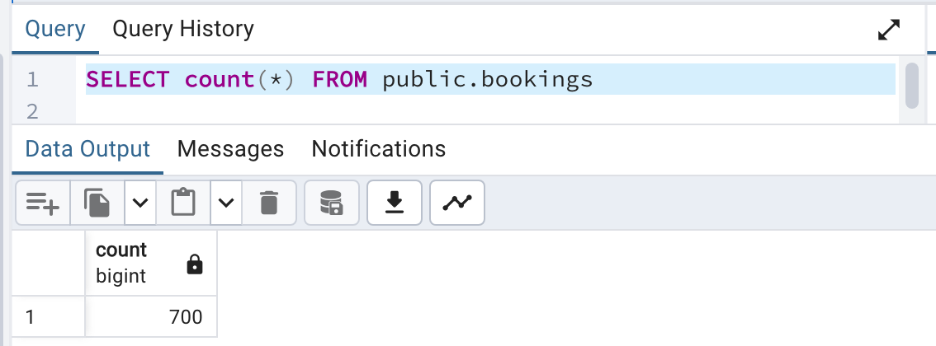

Slide 10
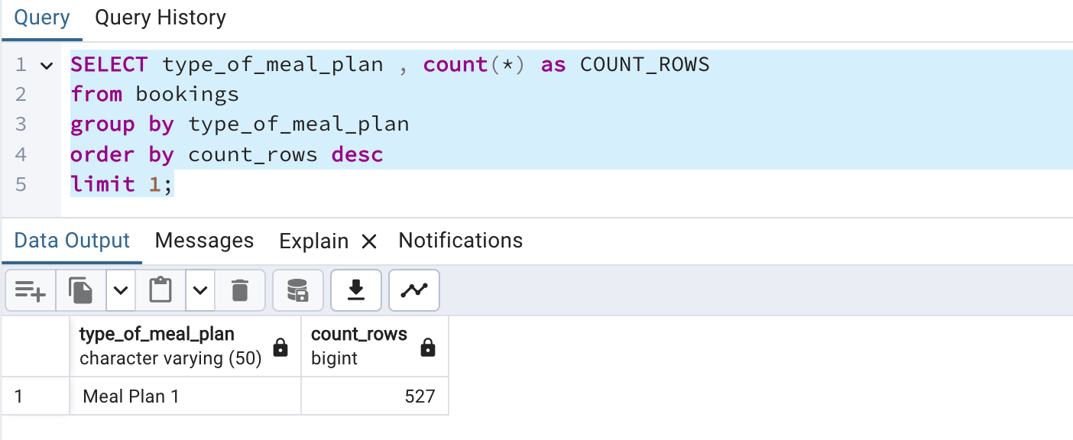

Slide 11
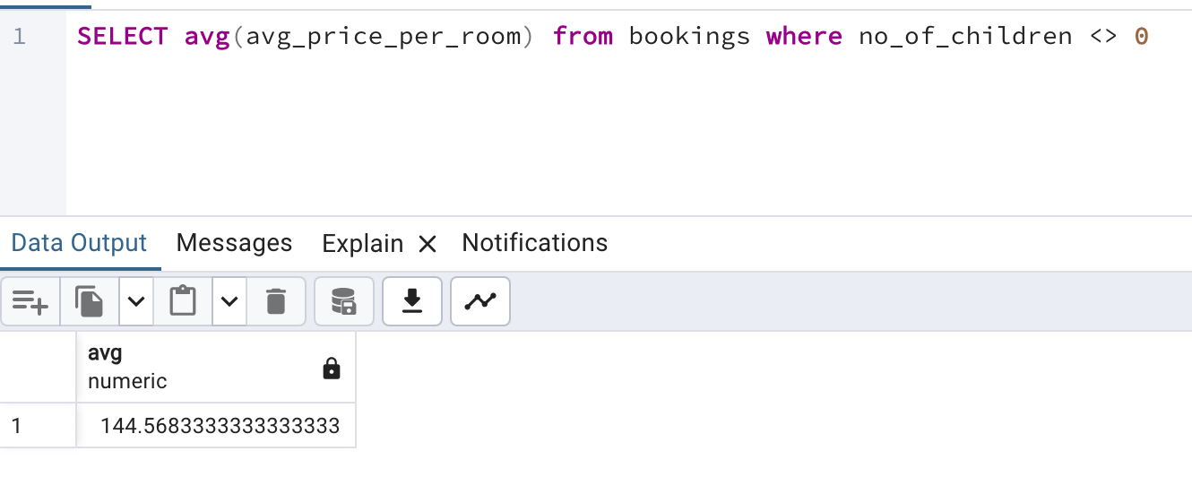

Slide 12
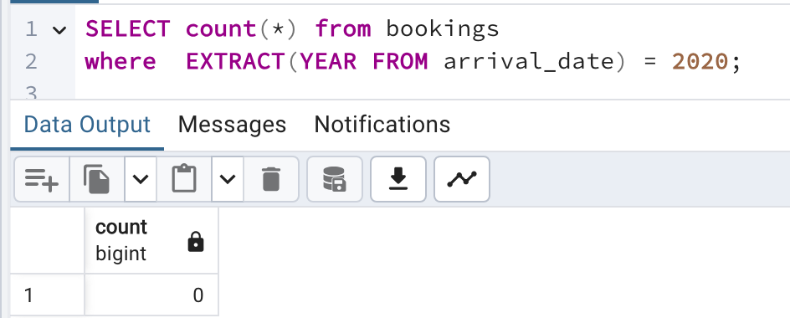

Slide 13
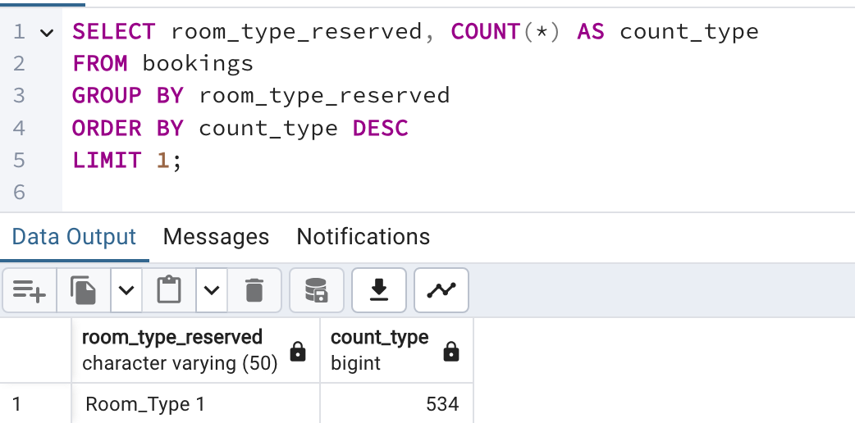

Slide 14
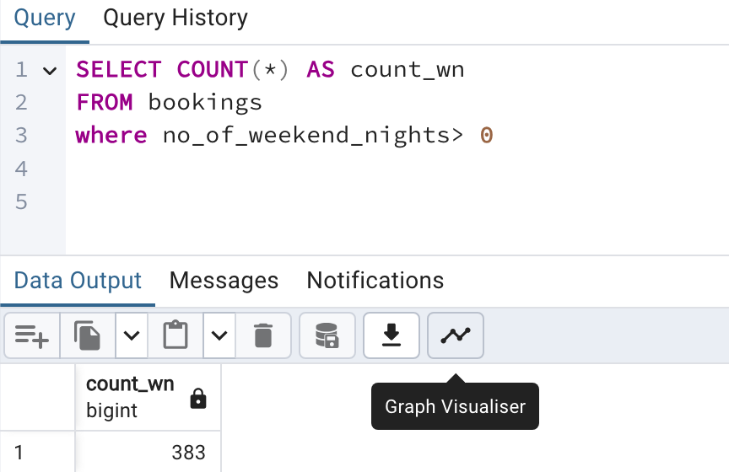

Slide 15
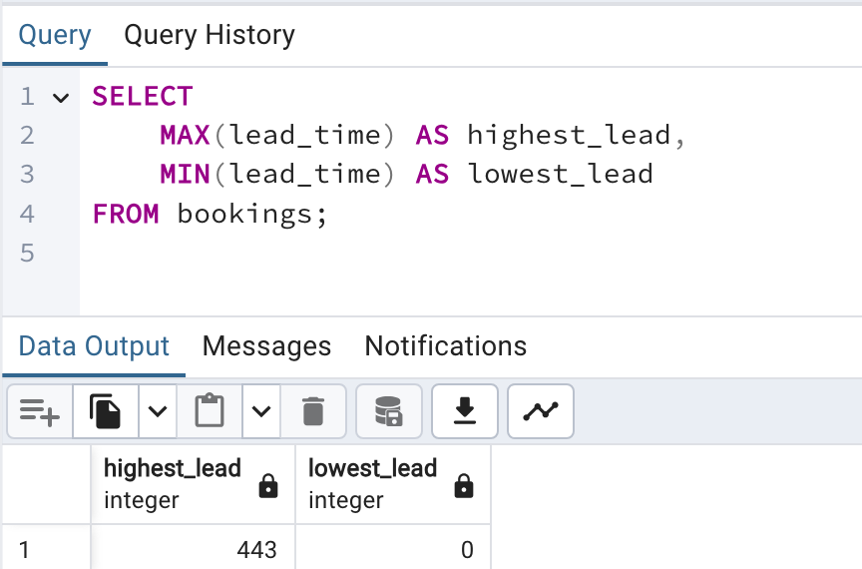

Slide 16
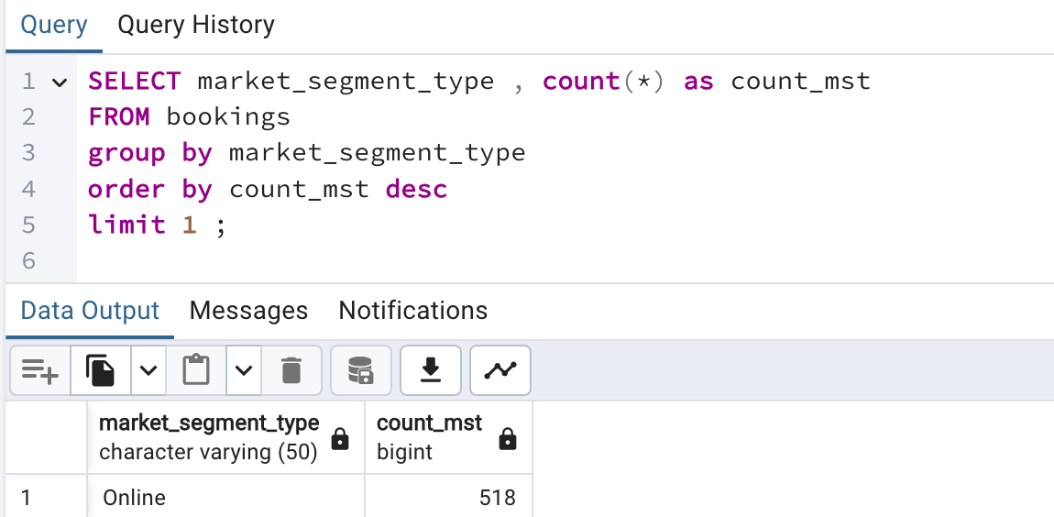

Slide 17
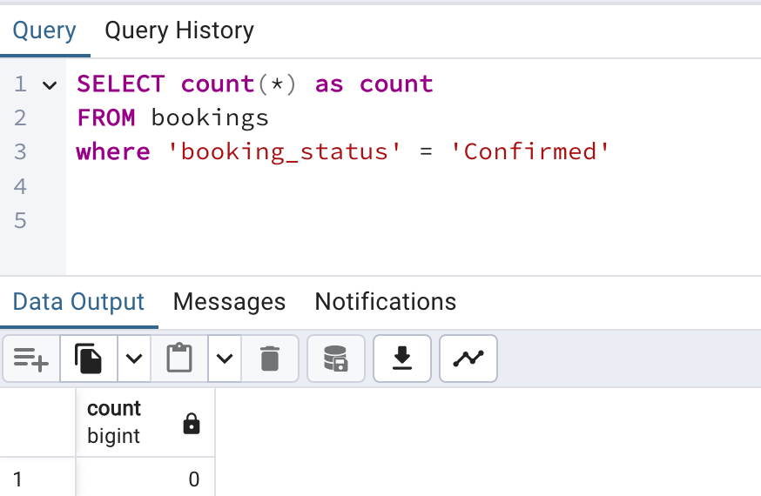

Slide 18
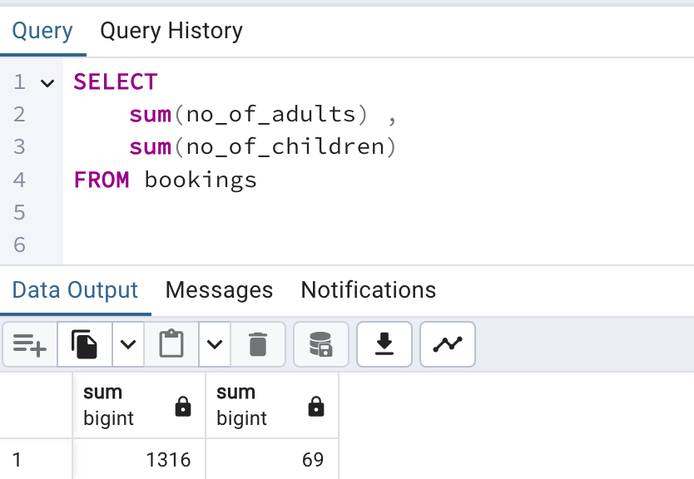

Slide 19
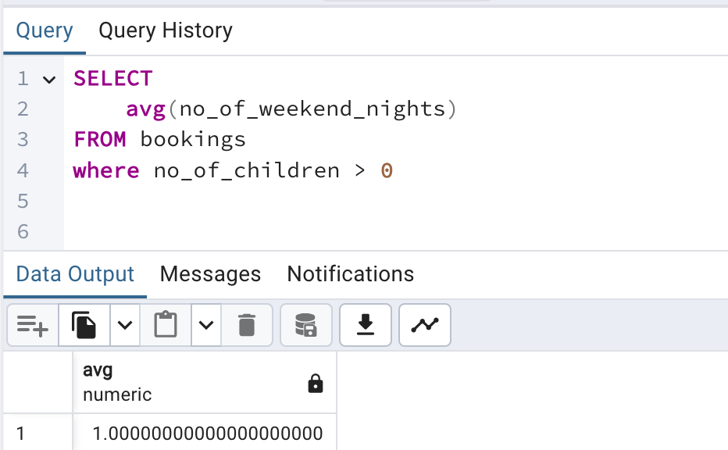

Slide 20
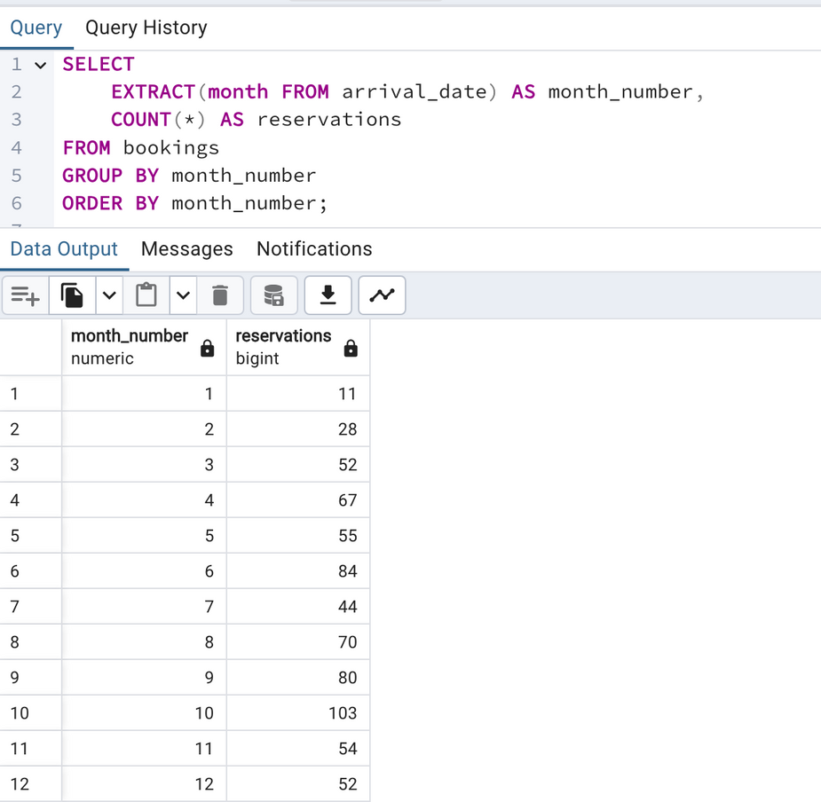

Slide 21
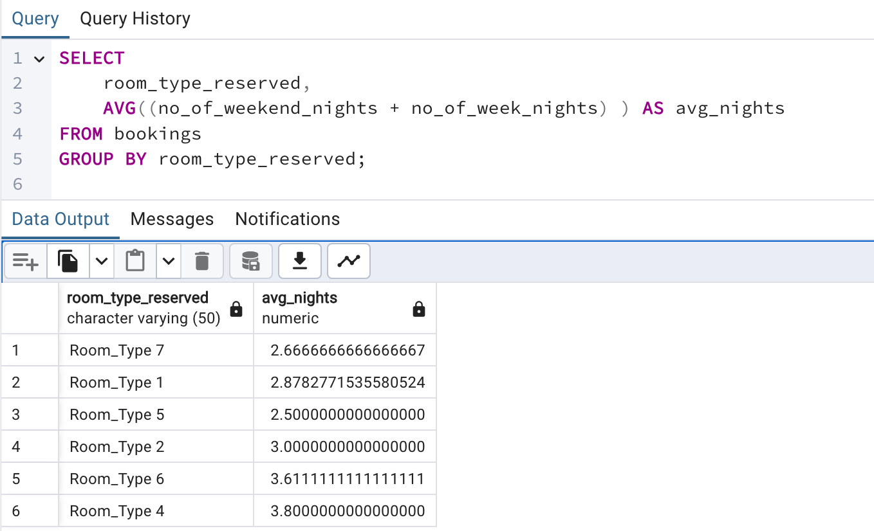

Slide 22
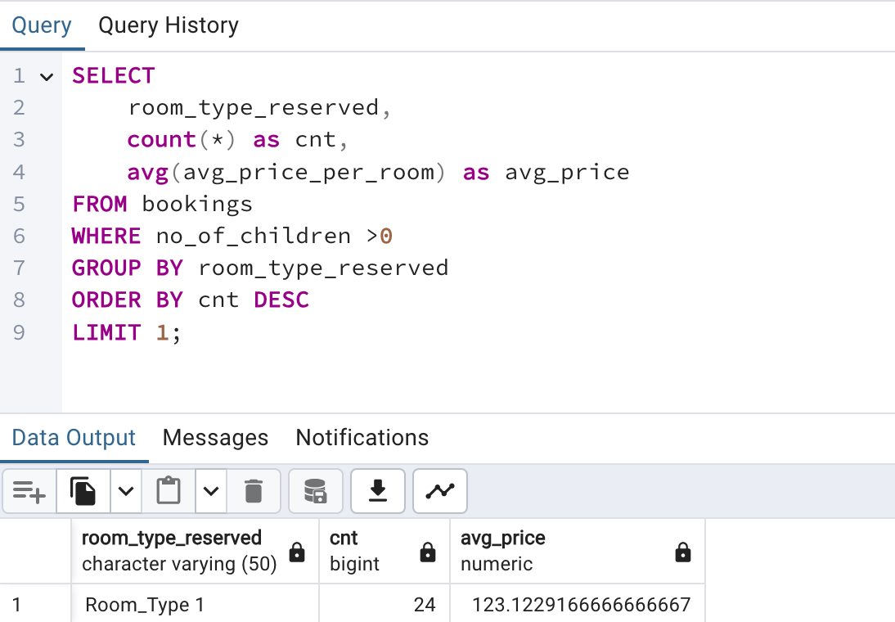

Slide 23
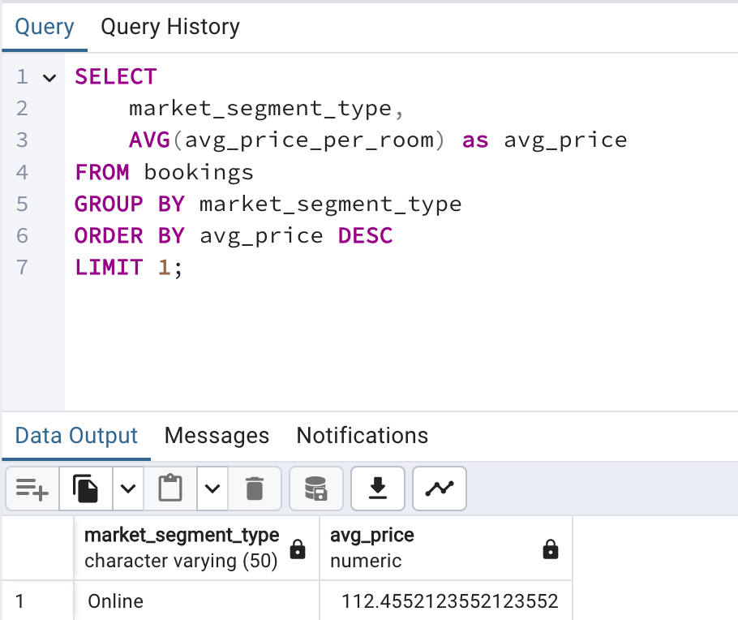

Slide 24
Conclusion
The hotel booking dataset provides several key insights:
The most popular meal plan is 'Meal Plan 1' and the most common room type is 'Room Type 1'. There were 123 reservations made in 2017, with 383 including weekend nights.
The average room price for reservations involving children is 144.57 units, with lead times ranging from 0 to 443 days.
The 'Online' market segment is the most common and generates the highest average price per room. In total, there are 1316 adults and 69 children across all reservations, which can inform strategic decisions around guest demographics and experiences.

Slide 25


THANK YOU FOR YOUR ATTENTION
Calle Cualquiera 123, Cualquier Lugar

